Slide 1
Gradient Descent & ANN Anatomy
UIUC ECON 490: Applied Machine Learning in Economics

Slide 2
Gradient Descent
Batch Gradient Descent
Stochastic Gradient Descent
Mini-batch Gradient Descent

Slide 3

Loss Minimization
Generalized Case
$$L\left(X,y;θ\right)$$
Regression problems
$$MSE\left(X,y;θ\right)=\frac{1}{n}\sum_{i=1}^{n}{(}y_{i}−f\left(X_{i};θ\right))^{2}$$
OLS
$$=\frac{1}{n}\sum_{i=1}^{n}{(}y_{i}−X_{i}^{′}θ)^{2}$$

Slide 4
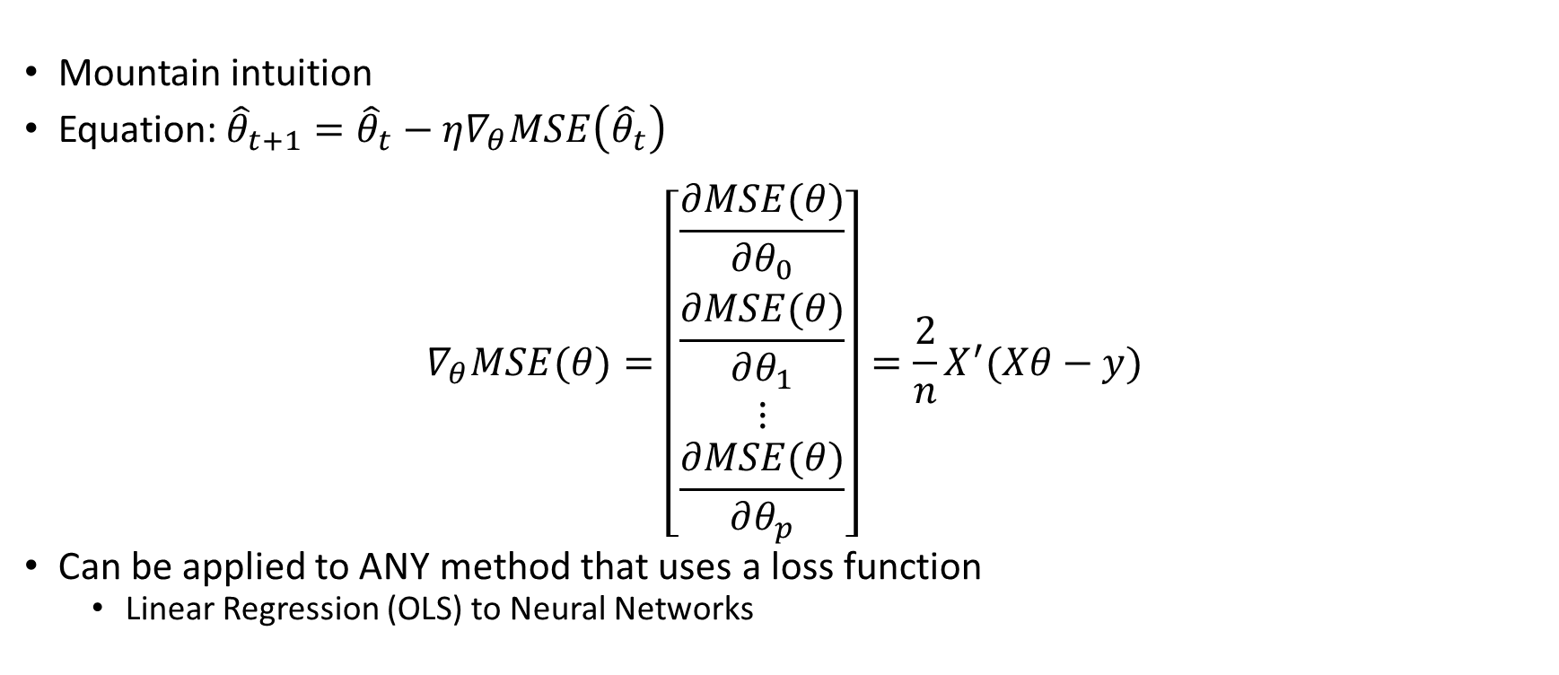
Gradient Descent – Intuition
Mountain intuition
Equation:${\hat{θ}}_{t+1}={\hat{θ}}_{t}−η∇_{θ}MSE\left({\hat{θ}}_{t}\right)$
$$∇_{θ}MSE(θ)=\left[\begin{matrix}\frac{∂MSE(θ)}{∂θ_{0}} \\ \frac{∂MSE(θ)}{∂θ_{1}} \\ ⋮ \\ \frac{∂MSE(θ)}{∂θ_{p}}\end{matrix}\right]=\frac{2}{n}X^{′}(Xθ−y)$$
Can be applied to ANY method that uses a loss function
Linear Regression (OLS) to Neural Networks

Slide 5
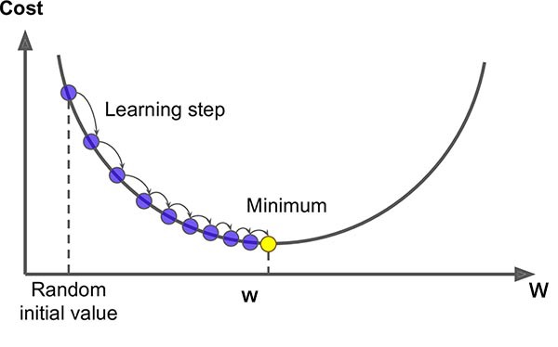
Gradient Descent
Source: Medium – An Introduction to Gradient Descent

Slide 6
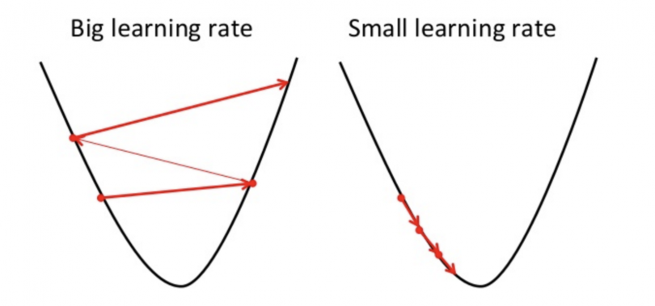
Gradient Descent – Learning Rate
Source: Medium – An Introduction to Gradient Descent

Slide 7
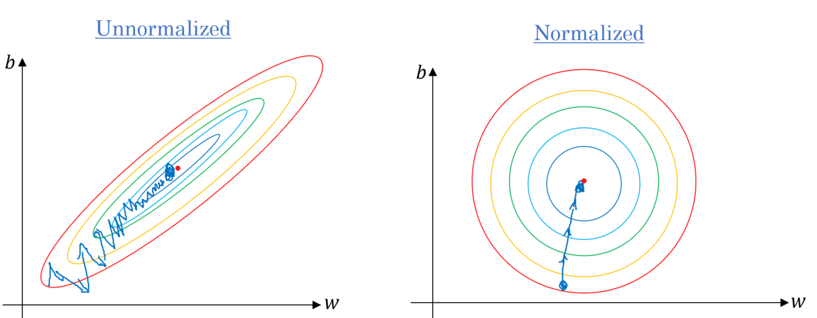
Gradient Descent – Scale
Source: Medium – An Introduction to Gradient Descent

Slide 8

Univariate Example
$f(x)=x^{2}⟹f^{′}(x)=2x$
$x_{0}=2$
$η=0.1$
$x_{1}=x_{0}−η×2(x_{0})=2−0.1×4=1.6$
$x_{2}=1.6−0.1×2(1.6)=1.28$
$η=10$
$x_{1}=2−10×2(2)=−38$
$x_{2}=−38−10×2(−38)=722$

Slide 9
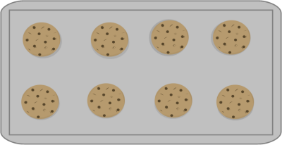
Batch Gradient Descent

Slide 10

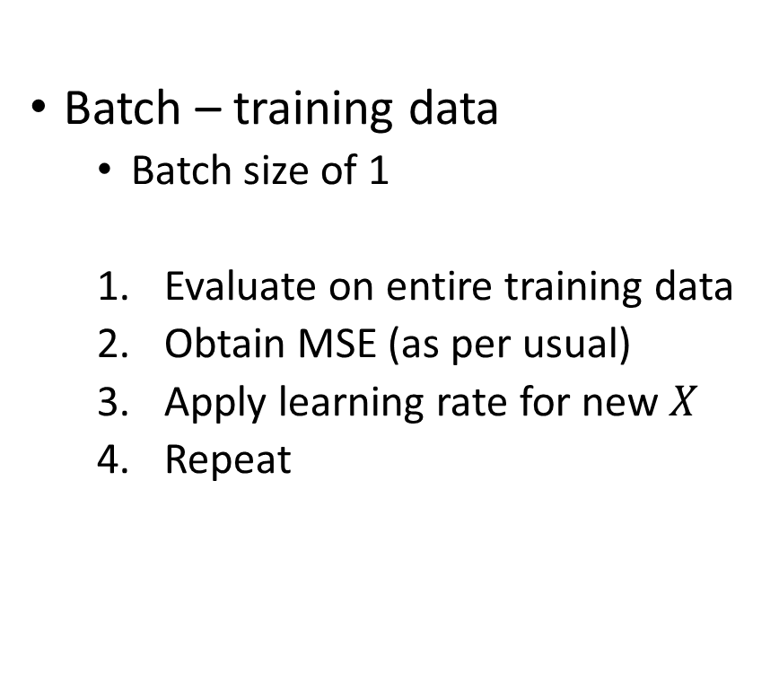
Batch Gradient Descent
Batch – training data
Batch size of 1
Evaluate on entire training data
Obtain MSE (as per usual)
Apply learning rate for new $X$
Repeat
Pros
Will converge as $n→∞$
Cons
SLOW
Can get stuck at non-global (local) minima

Slide 11
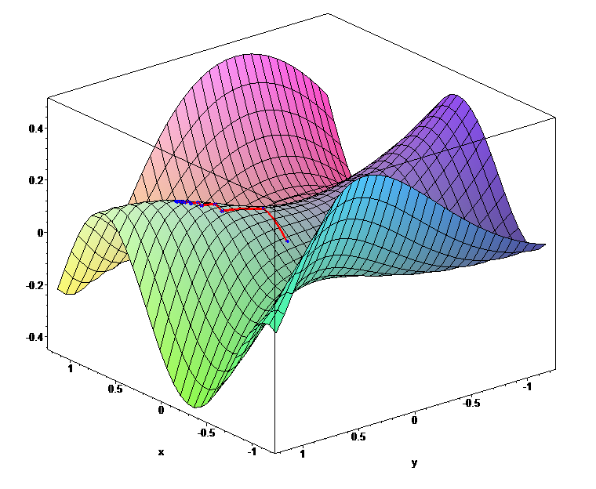
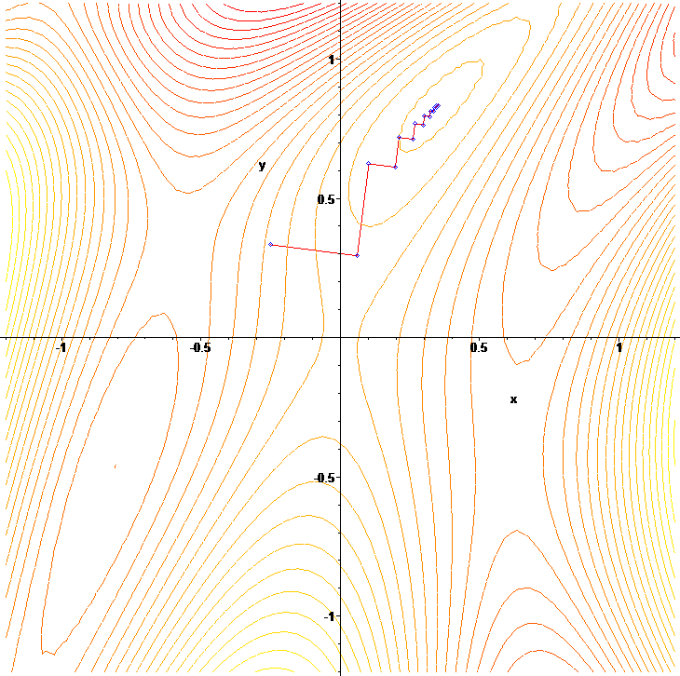
Batch Gradient Descent
Source: Wikipedia – Gradient Descent

Slide 12
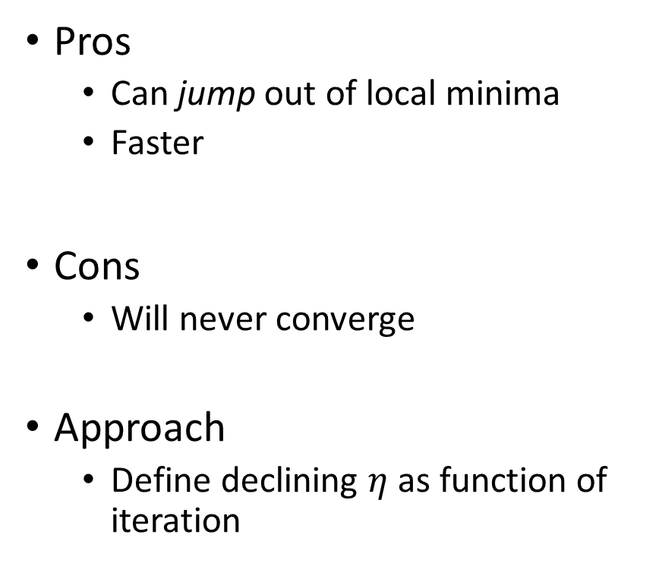
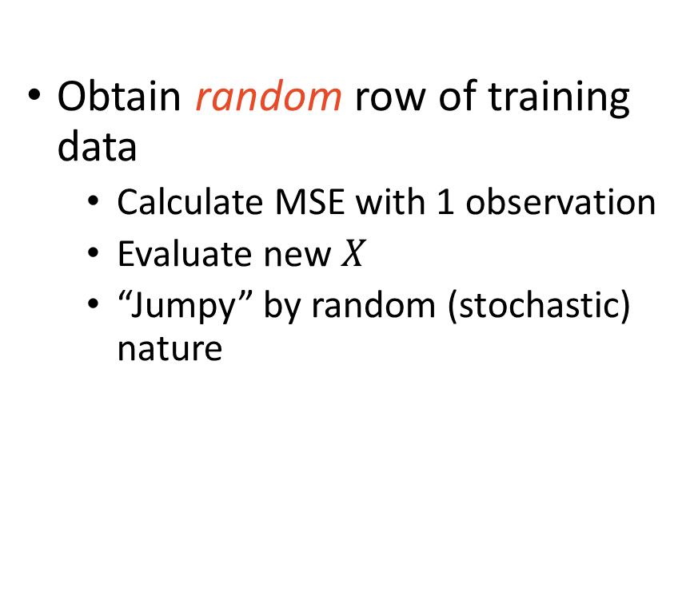
Stochastic Gradient Descent
Obtain random row of training data
Calculate MSE with 1 observation
Evaluate new $X$
“Jumpy” by random (stochastic) nature
Pros
Can jump out of local minima
Faster
Cons
Will never converge
Approach
Define declining $η$ as function of iteration

Slide 13
Mini-batch Gradient Descent
Analogous to cross-validation
Balance of BGD & SGD
Batch (folds) use 2 – 32
Pros
Can escape local minima
Never converges but closer than SGD
Stable
Fast

Slide 14
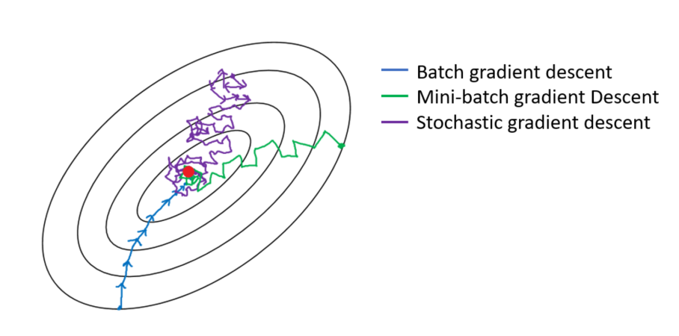
Comparison

Slide 15
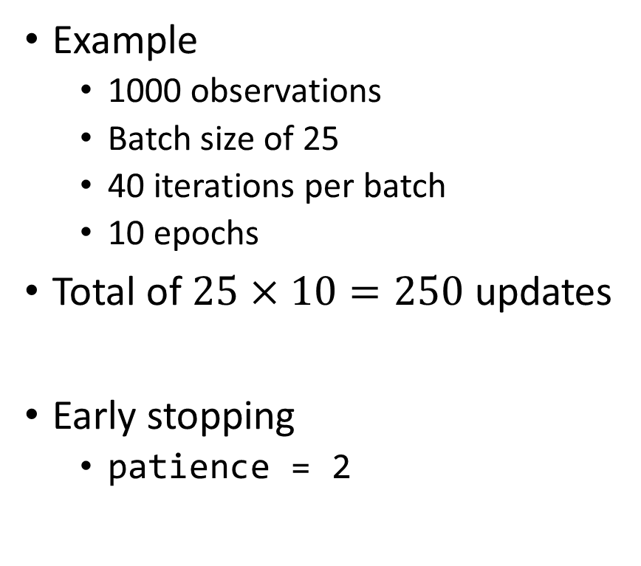
Terminology
Batch (folds)
keras defaults to 32
Epoch (repeats)
keras defaults to 10
Iterations (fold size)
Example
1000 observations
Batch size of 25
40 iterations per batch
10 epochs
Total of $25×10=250$ updates
Early stopping
patience = 2

Slide 16
Artificial Neural Networks
The moment you have been waiting for!

Slide 17
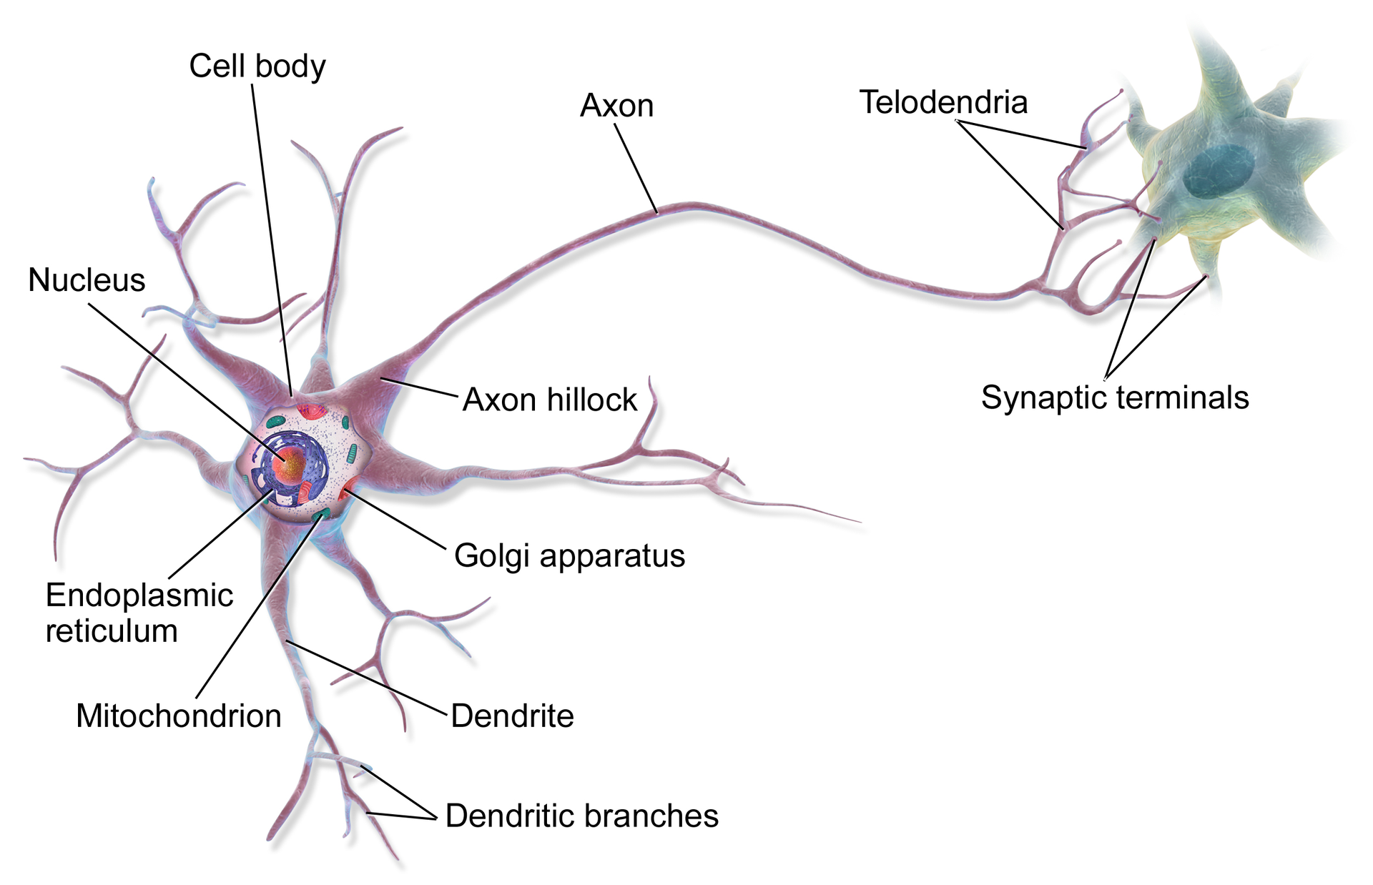
Biological Neurons

Slide 18
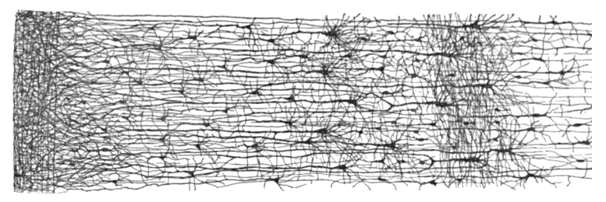
Neurons that Wire Together, Fire Together

Slide 19
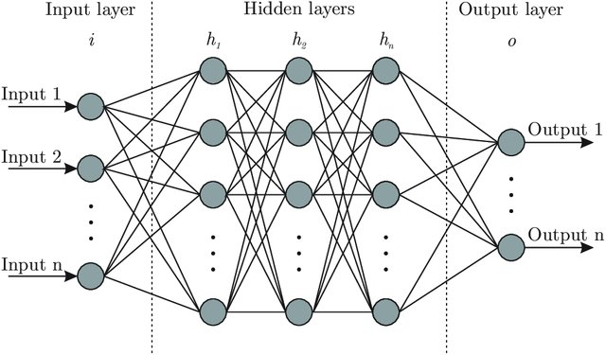
Neural Network Anatomy

Slide 20
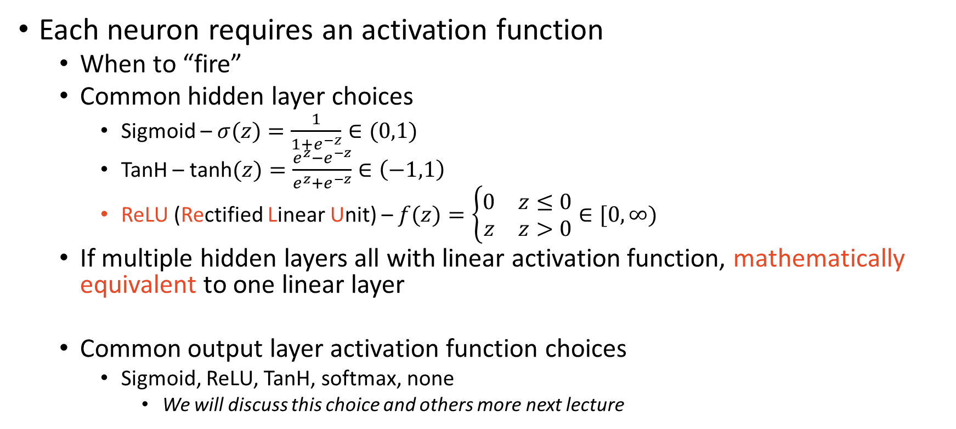
Neural Network – Hidden & Output Layers
Each neuron requires an activation function
When to “fire”
Common hidden layer choices
Sigmoid – $σ(z)=\frac{1}{1+e^{−z}}∈(0,1)$
TanH – $\text{tanh}(z)=\frac{e^{z}−e^{−z}}{e^{z}+e^{−z}}∈\left(−1,1\right)$
ReLU (Rectified Linear Unit) – $f(z)=\left\{\begin{matrix}0 & z≤0 \\ z & z>0\end{matrix}\right.∈[0,∞)$
If multiple hidden layers all with linear activation function, mathematically equivalent to one linear layer
Common output layer activation function choices
Sigmoid, ReLU, TanH, softmax, none
We will discuss this choice and others more next lecture

Slide 21
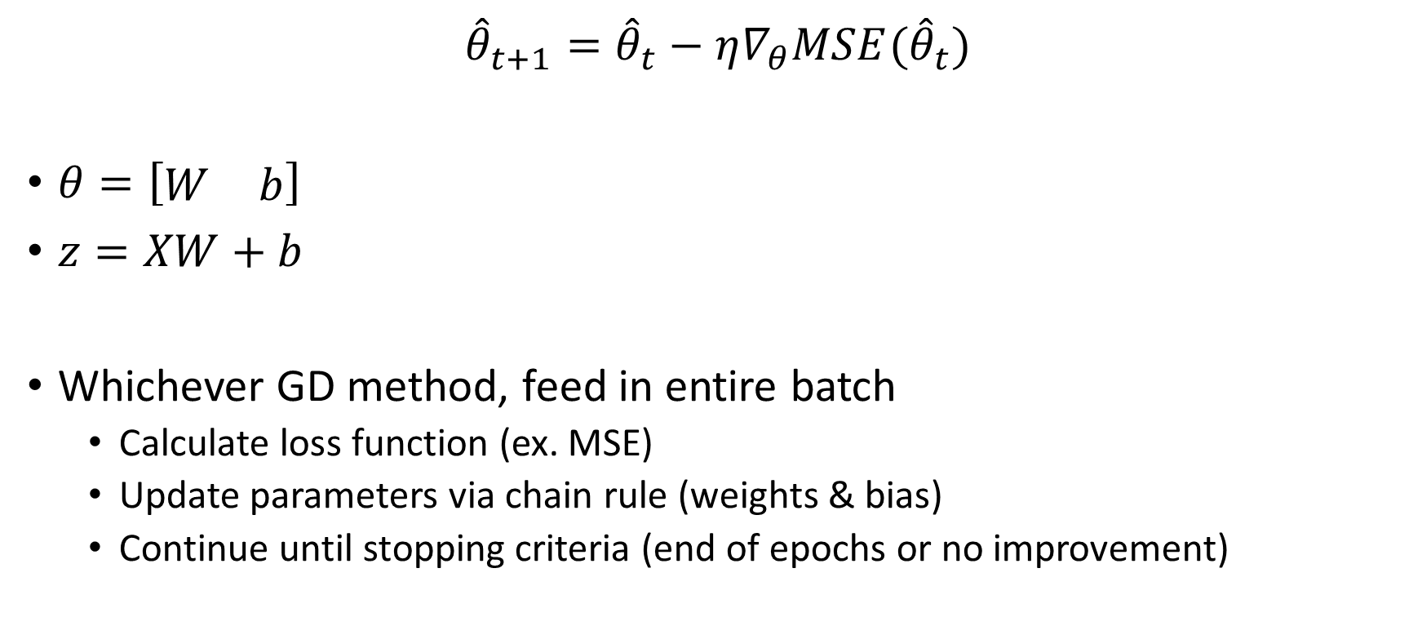
Feedforward NN & Back-propagation
$${\hat{θ}}_{t+1}={\hat{θ}}_{t}−η∇_{θ}MSE({\hat{θ}}_{t})$$
$θ=\left[\begin{matrix}W & b\end{matrix}\right]$
$z=XW+b$
Whichever GD method, feed in entire batch
Calculate loss function (ex. MSE)
Update parameters via chain rule (weights & bias)
Continue until stopping criteria (end of epochs or no improvement)

Slide 22

To Do
You must do this to use neural network in R
Download anaconda (Google “install anaconda”) from anaconda.com
Required for NN packages
In R, run the following:
install.packages(“tensorflow”)
library(tensorflow)
install_tensorflow()
install.packages(“keras”)
library(keras)
install_keras()

